Slide 1

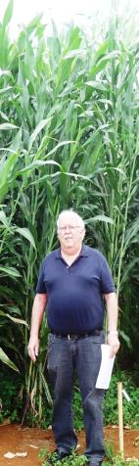
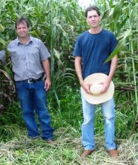



“Ethanol Production from Sweet Sorghum in Brazil – Industrial Application in the Sugarcane Sector”
Rafael A.C. Parrella, Dr. Cynthia Damasceno
& Robert E. Schaffert (SweetFuel Brazil)
w/ collaboration of Andre May and Evandro
C. Mantovani, (Embrapa Maize and Sorghum)
June 26, 2014 - 10:15 – 15:00
22nd European Biomass Conference and Exhibition
Hamburg, Germany
rafael.parrella@embrapa.br
robert.schaffert@embrapa.br
reschaffert@hotmail.com

Slide 2
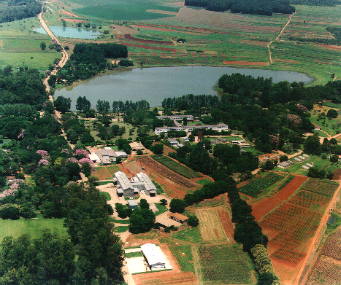

Embrapa Maize & Sorghum
Sete Lagoas-MG, Brazil

Slide 3
Presentation Outline
Minimum Ethanol Productivity (L/t and L/ha)
Productivity = f(Genotype + Production System + Industrial Management)
Genotype – Variety vs. Hybrid
(Seed Producer vs. Biomass Producer)
(Hybrids are the future sweet sorghum cultivars
Production System - Planting time, conventional
vs. minimum or no-till, row spacing,
fertilizer and plant density vs. harvesting
system, etc.
Industrial Management - Know you cultivar
(Period of Industrial Utilization)
Ideal Cultivar
Sweet Sorghum Cultivar (Variety & Hybrid) Development
Biomass Energy Sorghum Cultivar (Hybrid) Development

Slide 4
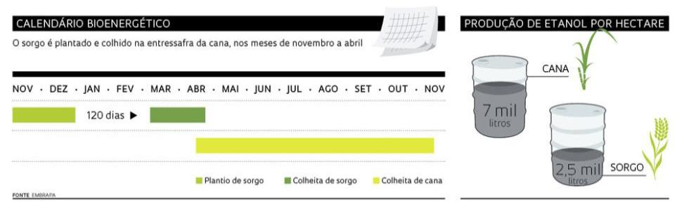
Scenarios for Sweet Sorghum in Brazil
Sweet sorghum is being proposed to be planted at the beginning of the rainy season in areas of Sugarcane renovation to increase the period of operation of large distilleries in Brazil by up to 100 days.(Initially 15 - 60 days)
Bioenergy Calendar
Ethanol Production L ha⁻¹
Cane
Cane
580 L /month
120 -130 days
750 L /month
3 mil litros
Harvest Sorghum
Sorghum
Plant Sorghum
Harvest Sugarcane
Plant Sorghum
Harvest Sorghum
Harvest Sugarcane

Slide 5
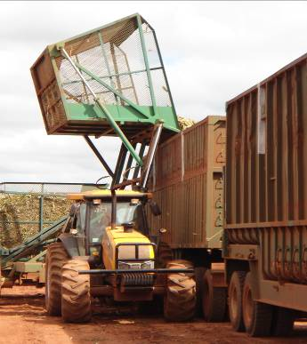
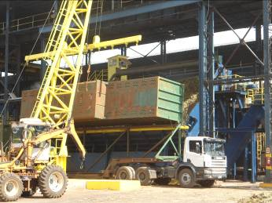
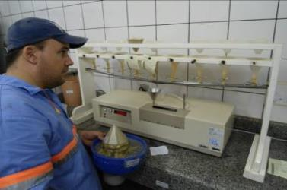
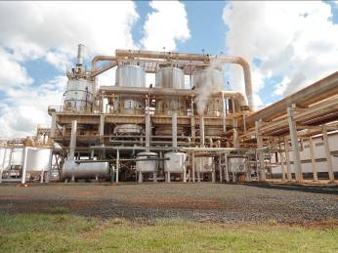
Utilizing Sugarcane Distilleries for Sweet Sorghum Processing
Some Fine Tuning may be Necessary, but Minimal

Slide 6
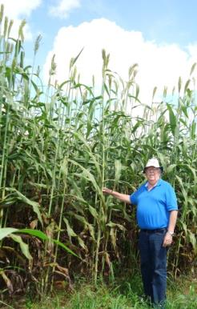
“Minimum Economic Thresholds” for a sweet sorghum cultivar in Brazil, now and in the future
Parameter | 2009/ 2011 | 2013/ 2014 | Goal
Biomass Production (t ha⁻¹) | > 40 | > 50 | > 60
Total Sugar (% Juice) | > 12.5 | > 12.5 | > 14
Ethanol Production (L t⁻¹⁾ | > 60 | > 60 | > 70
Ethanol Production (L ha⁻¹) | > 2400 | > 3000 | > 4200
PIU (days) | > 30 | > 30 | > 30

Slide 7
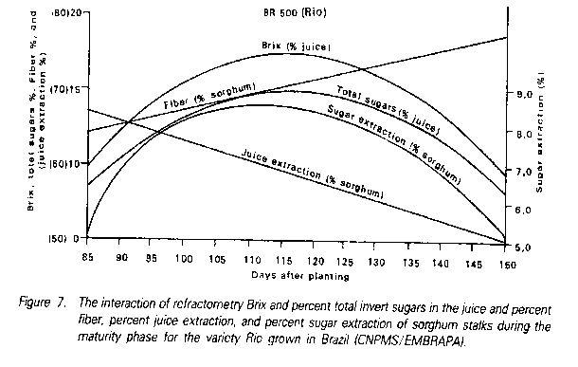
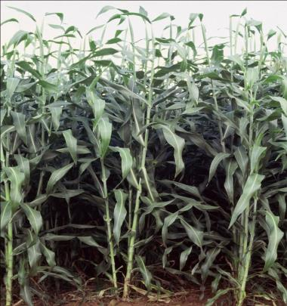
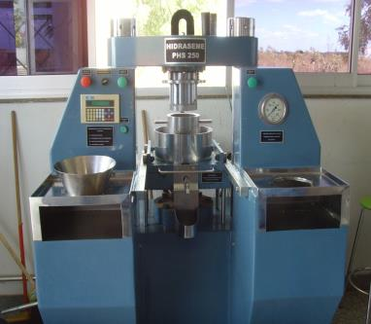
RIO BR500
Sweet Sorghum Industrial Management
(Embrapa Maize and Sorghum)
PUI – 32 days
Construction of Maturity Curves to Determine “Period of Industrial Utilization” (PIU)
Interaction of Brix, ART, fiber, juice extraction, and sugar extraction from sweet sorghum during the maturity phase; sampling at seven day intervals for a period of 7 – 10 weeks, beginning 10-15 days after flowering.
Cultivars are Different !!!
xxxxxxxx
Hydraulic Press for
standardized comparisons

Slide 8
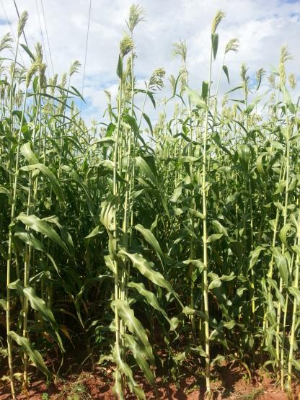
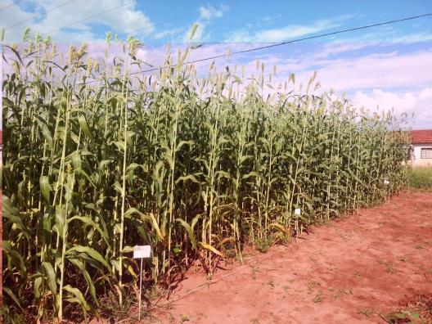
Embrapa Released Sweet Sorghum Varieties - 2013
BRS511
BRS509
BRS508
BRS506
15
BRS506

Slide 9
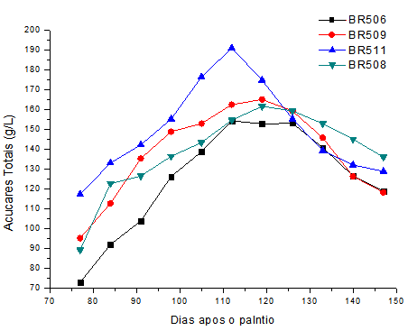
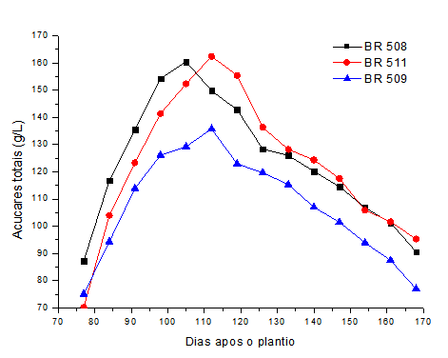
Maturity Curves (Total Sugar-% juice) for Three New Sweet Sorghum Cultivars in Ituiutaba-MG (Large G x E Interaction)
2011/2012
2012/2013
2012
2013
Açúcar Extraido (% Caldo)
Brix Extraido
16

Slide 10
Production System Depends upon Machinery Technology in Brazil for Planting and Harvesting Sweet Sorghum
No-Till Planter Mechanized Harvesting
Reaching Desired Stand
Critical for Maximum
Production

Slide 11
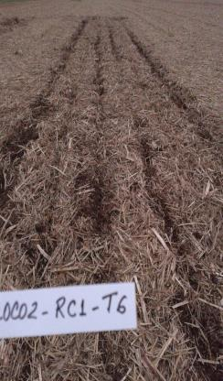
Sweet Sorghum No-till Planting
COP CA – Marchesan Planter
Matão, SP, Brazil.
(Photos: Evandro Chartuni Mantovani, 2012/2013 - Embrapa Maize and Sorghum.
Contact: evandro.montovani@embrapa.br
Cutting disk-24” view working in residual sugar cane stalks and a steel shank of soil preparation .
11

Slide 12
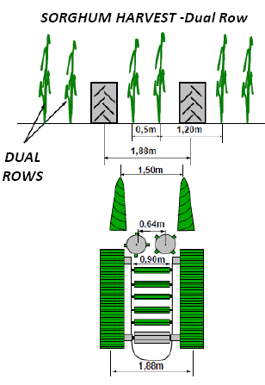
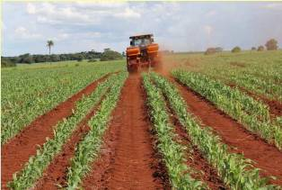
Loss of Production Potential
Illustration of sugarcane harvester

Slide 13
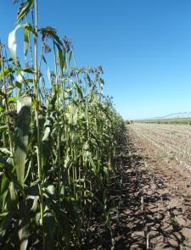
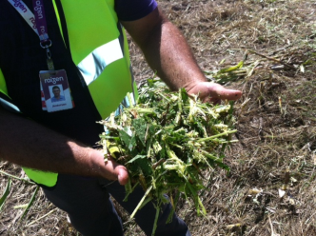
Sweet Sorghum Harvesting
New Prototype: Faster & More Economical
Maximum length of stem pieces obtained by reducing number of knives: 8 cm.
Self-propelled forage harvesters in sweet sorghum pilot areas in SP and MS,Brazil.
John Deere & New Holland
(Photos: Evandro Chartuni Mantovani, 2013 - - Embrapa Maize and Sorghum.
Contact: evandro.montovani@embrapa.br.

Slide 14
Production System Recommendations
for New Embrapa Sweet Sorghum Varieties
BRS 506, 508, 509 and 511
Best row spacing - 0.5 or 0.7m
Best Plant Density – 120 to 140,000 plants ha⁻¹
Nitrogen – 120 kg ha⁻¹
(40 kg at planting and 80 kg at 4 leaf stage)
Insect Control when necessary
> 2,500 L ha⁻¹ ethanol “when all goes well” (on pilot scale ie. > 50 t/ha)
Recommendations of André May in pilot trials with Embrapa Milho e Sorgo Varieties
E-mail: andre.may@embrapa.br
Telefone: +55-19-3311.2700

Slide 15
Principal Bottlenecks - Industrial Management
Maturity Curves for Each Cultivar to Establish a Period of Industrial Utilization (PIU)
are Necessary for Industrial Planning
The interaction of: Brix, total sugars, fiber, juice extraction, and sugar extraction of Sweet Sorghum Stalks at 7 day intervals using a standardized methodology (Hydraulic Press)
Current Definition of PIU at Embrapa
Minimum ART* - 12.5%
Minimum Sugar Extraction* - 80 kg t⁻¹ biomass
Minimum Time - 30 days
* These values can be adjusted or to meet different requirements
“Be Careful – Do not plant cultivars that do not have PIU information”

Slide 16
Principle Breeding Bottleneck Today
CULTIVAR | Production (t ha⁻¹) | BRIX | PUI (days)
VARIETY | 60 | 15-20 | 30 - 40
HYBRID | 50 | < 13 | <<< 20
The female line of the hybrid is juicy, but not “sweet” or
not sufficiently sweet (First Commercial Hybrids),
Brix of these hybrids is only slightly more than mid-parent,
The hybrids have large panicles and high grain production,
Hybrids have a greater tendency for lodging, and
Some hybrids have greater tendency to have pithy stems.
Challenge: Develop sweet sorghum A and B lines
that are juicy, sweet and produce hybrids with small panicles.

Slide 17
Principal Bottlenecks - Seed Supply
Lack of Sweet Females to Produce Hybrids
Embrapa Response (SweetFuel)
Release additional varieties
Fast Track Development of 3 Dwarf Juicy Sweet Female A and B – Lines from both BxR and BxB crosses
Juicy Stem
High Sugar (Sucrose)
Small Panicle
Low GCA for Grain
High GCA for Biomass (Yield)

Slide 18
Fast Track Development of Sweet Sorghum Female Lines
Year | B - Line | A - Line | Activity
2008/2009 | F1; F2; RC1 |  | B x R crosses & advance generation
2010 | F2:3 |  | Phenotype selection
2011 | F3:4 | P1 | Select, advance & cross to A1 cytoplasm
2011 | F4:5 | F1 | Select, advance & backcross to A1 cytoplasm
2012 | F5:6 | BC1 | Select, advance & backcross to A1 cytoplasm
2012 | F6:7 | BC2 | Select, advance & backcross to A1 cytoplasm
2013 | F7:8 | BC3 | Select, advance & backcross to A1 cytoplasm
2013 | F8:9 | BC4 | Advance, backcross to A1 cytoplasm Develop Experimental Hybrids
2014 | F9:10 | BC5 | Increase seed of selected lines and experimental hybrid evaluation

Slide 19
Evaluation of Eight New Sweet Sorghum Female A and B Lines - 2013
Entry | Cytoplasm | Generation | Plant Height (m) | Brix 100 DAP | Brix 106 DAP | Brix 113 DAP
2013001 | A1 | BC4 | 1,20 | 12,50 | 12,90 | 15,60
2013002 | B | F8:9 | 1,20 | 14,80 | 13,20 | 14,40
2013003 | A1 | BC4 | 1,60 | 13,50 | 13,50 | 16,90
2013004 | B | F8:9 | 1,60 | 14,70 | 14,80 | 11,40
2013005 | A1 | BC4 | 1,65 | 13,00 | 14,60 | 16,10
2013006 | B | F8:9 | 1,65 | 15,00 | 15,70 | 14,40
2013007 | A1 | BC4 | 1,55 | 15,60 | 12,80 | 16,30
2013008 | B | F8:9 | 1,55 | 16,20 | 15,70 | 14,80
2013009 | A1 | BC4 | 1,50 | 11,30 | 13,10 | 16,70
2013010 | B | F8:9 | 1,50 | 14,80 | 15,60 | 16,10
2013011 | A1 | BC4 | 1,75 | 12,80 | 14,00 | 19,70
2013012 | B | F8:9 | 1,75 | 15,00 | 15,80 | 13,30
2013013 | A1 | BC4 | 1,20 | 9,70 | 11,40 | 13,80
2013014 | B | F8:9 | 1,20 | 9,70 | 9,20 | 13,70
2013015 | A1 | BC4 | 1,70 | 13,60 | 14,70 | 13,10
2013016 | B | F8:9 | 1,70 | 16,00 | 16,60 | 17,60

Slide 20
Experimental Sweet Sorghum Hybrid Trial
2013/2014 Average of Three Locations
Average | Biomass Yield | BRIX* | Height | Total Extracted Brix | Total Extracted Sugars
 | (t ha⁻¹ ) | (% Juice) | (m) | (t ha-1 ) | (t ha-1 )
Experimental Hybrids (EH) | 57,75 | 15,40 | 2,67 | 4,62 | 3,69
Best EH | 72,26 | 15,21 | 2,71 | 5,69 | 4,55
Best three EH | 64,42 | 16,63 | 2,71 | 5,51 | 4,40
Best nine EH | 59,65 | 15,84 | 2,70 | 4,90 | 3,92
New Varieties | 60,32 | 16,54 | 2,70 | 4,99 | 3,99
Released Varieties | 57,25 | 17,25 | 2,64 | 4,82 | 3,86
Commercial Check | 67,97 | 12,88 | 2,65 | 4,70 | 3,76
*All experimental hybrids and varieties above Brix threshhold (14.5)

Slide 21
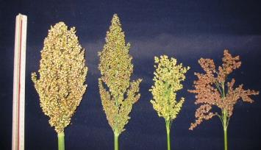
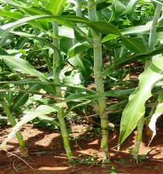
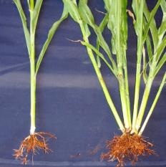
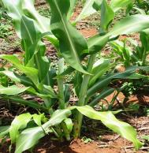
Ideal Sweet Sorghum Idiotype
Panicle Type
Small Panicle Preferred
Less Lodging
Less Competition for
Photosynthates
Reduced Harvest and ProcessingComplications
Tillering
No tillering Preferred
Better Control of Stem Population
Larger Stem Diameter
Better Juice Quality

Slide 22
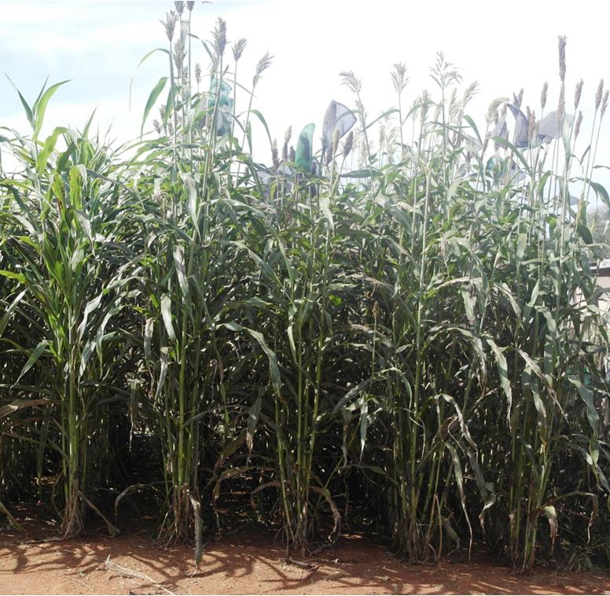
“Off Season” Photo and Brix of Three Additional
Sweet Sorghum Varieties to be Released in 2014 (short daylength and cool nights)
Not sensitive to short days
CMSXS643 CMSXS646 CMSXS647 BRS 511 BRS 508
22/10/2013 | 8.70 | 10.70 | 7.90 | 9.60 | 12.90
29/10/2013 | 11.80 | 12.30 | 11.40 | 12.00 | 17.80
05/11/2013 | 12.10 | 14.20 | 11.10 | 12.80 | 17.00
20

Slide 23
High Biomass Sorghum
Initially our objective to develop photosensitive (PS) high biomass yielding sorghum hybrids was to provide feedstock for 2nd generation (G2) technology to produce ethanol.
There is a growing demand in Brazil for biomass feedstock similar to sugarcane and sorghum bagasse for burning to produce steam for industrial processes and for generating electricity.

Slide 24
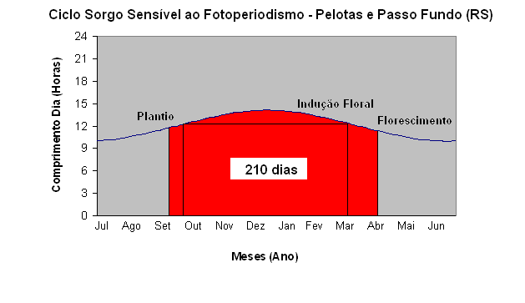
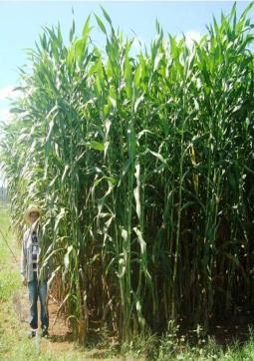
Development of Photosensitive* Sorghum (PS) Hybrids for Biomass Production
Daylength
Flowering
Month
Floral Induction
Planting
Planting
Harvest
* Flowering induced with day length less than 12h and 15 min

Slide 25
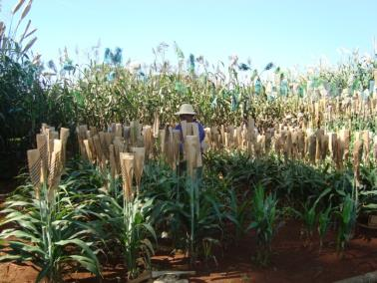
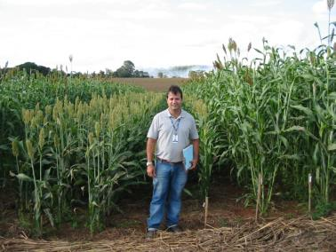
Obtaining lignocellulosic sorghum hybrids
Window of opportunity where photo insensitive (PI) females flower (ma₁ma₁) at the same time as photosensitive (PS) R-lines (Ma₁Ma₁) to produce PS hybrids (Ma₁ma₁) (March – April Planting)
(Ma₁Ma₁)
(ma₁ma₁)
(Ma₁Ma₁)
(ma₁ma₁)
Male steril PI A-lines
PS R line
Hand crossing
Isolated Field
25

Slide 26
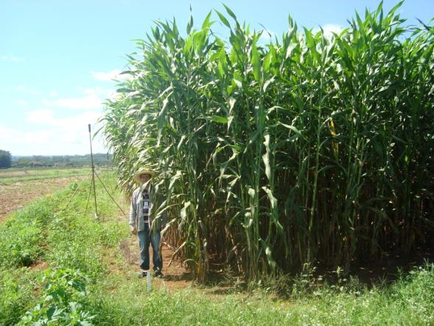
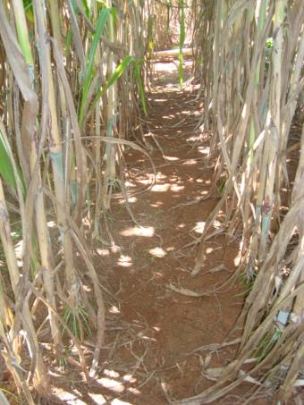
Evaluation lignocellulosic sorghum hybrids in Sete Lagoas, MG, Brazil 2010/2011/2012/2013/2014
(Ma₁ma₁)
110 days after planting
26

Slide 27
Dry Matter Production of Select Biomass Experimental Hybrids in Minas Gerais State 2012/2013 (t ha⁻¹)
Biomass Hybrid | Nova Porterinha-MG | Sete Lagoas MG | Santa Vitoria MG | Average
CMSXS7000 | 21.2 | 42.0 | 38.2 | 33.8
CMSXS7007 | 18.2 | 57.0 | 27.2 | 28.4
CMSXS7015* | 35.7 | 52.8 | 39.2 | 42.6
CMSXS7018 | 25.5 | 69.6 | 37.4 | 44.1
Forage Hybrid | 13.2 | 15.8 | 12.7 | 13,9
Average (Biomass) | 25.2 | 45.8 | 35.5 | 35.5
New Embrapa Biomass Hybrids Evaluated in Uruguay 2013/14
Temperate Climate
Experimental Biomass Hybrid (Embrapa) | Plant Height (m) | Fersh Biomass Production (t ha⁻¹) | Dry matter (%) | Dry Matter Production (t ha⁻¹)
1 | 4.8 | 84.3 | 29 | 24.3
2 | 4.9 | 124.3 | 26 | 32.6
3 | 5.0 | 100.7 | 22 | 21.8
4 | 4.8 | 131.1 | 28 | 37.1
5 | 4.9 | 89.3 | 28 | 25.3

Slide 28
Priliminary Results
Characteristic | Unit | Sorghum Biomassa | Energy Cana | Stems of Energy Cana | Elephante Grass
Superior Energy Content | Kcal /kg | 4298,4 | 4393,9 | 4417,8 | 4059,6
Inferior Energy Content | Kcal /kg | 3987,9 | 4059,60 | 4107,36 | 3377,0
Unpublished results: Embrapa Milho e Sorgo-2012
1 Mj = 238,85 Kcal Kg-1

Slide 29
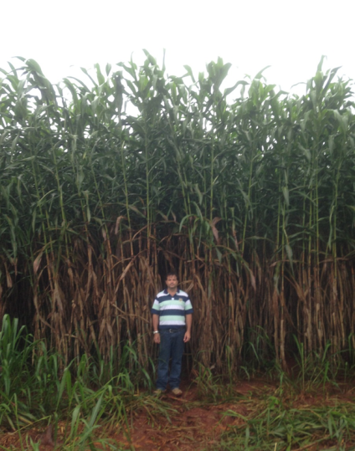
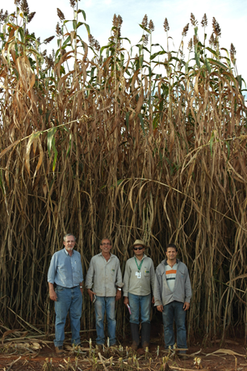
New Biomass Hybrid CMSXS7015*
150 DAP
206 DAP

Slide 30
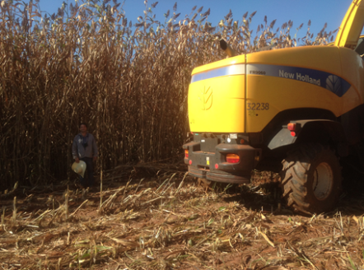
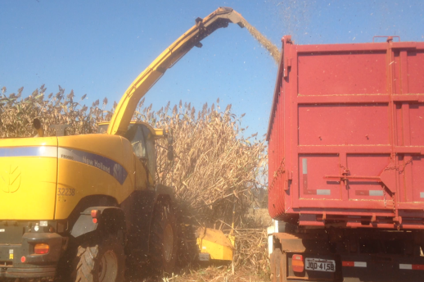
Harvesting New Biomass Hybrid
CMSXS7015 (Santa Vitoria –MG Brazil) May 2014
New Biomass Hybrid
CMSXS7015 Validated!!!

Slide 31
A Way Forward
Inter-Institutional Collaboration
Collaboration in Evaluating Embrapa
Cultivars in Temperate and Tropical
Environments
Collaboration in Developing SS Germplasm
with Improved Quality and Productivity
Contracts with Public and/or Private Sectors
Contract with Public and/or Private Sectors
Individual or Joint IP
36

Slide 32
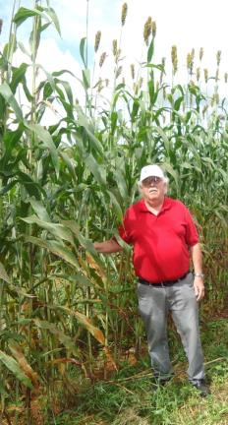
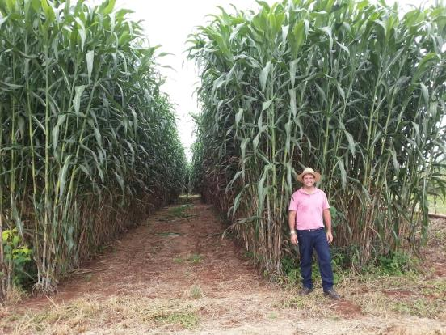
We would like to thank FP7, the European Commission for financial support and all our collaborators in the SweetFuel project over the past five years, and thanks to everyone here today.
Thanks - Obrigado!
robert.schaffert@embrapa.br
rafael.parrella@embrapa.br

